Slide 1
Lesson 1: Addition, subtraction, multiplication and division
Introduction to Electronics - mathematics

Slide 2
Practicalities
Marcello Millonzi, m.a.g.millonzi@saxion.nl
A lesson lasts twice 45 minutes
First a short instruction, then getting started yourself
Each lesson includes a Möbius test in two forms:
  An anonymous practice test (anonymous practice)
  A 'Homework or quiz' with deadline, max 4 attempts
    Conditional to be able to pass Introduction to Electronics
Score above 80%: test passed

Slide 3
Möbius and Brightspace
Möbius
Note notation:
See: mathematical formulas on Brightspace
Work neatly and work out the entire task on paper!

Slide 4
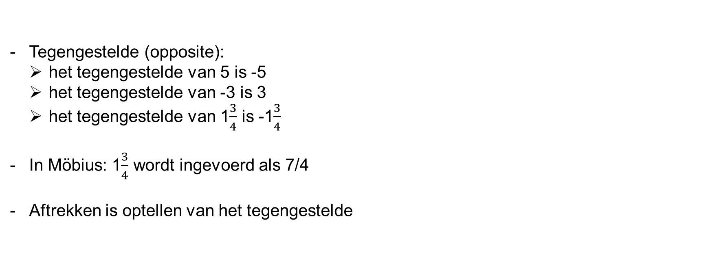
The number line
Opposite (opposite):
  the opposite of 5 is -5
  the opposite of -3 is 3
  the opposite of 1 is -1
In Möbius: 1 is entered as 7/4
Subtraction is addition of its opposite

Slide 5
Examples:
4 - 3 = 4 + (-3) = 1
4 - 4 = 4 + (-4) = 0
4 - 5 = 4 + (-5) = -1
4 - (-3) = 4 + 3 = 7

Slide 6

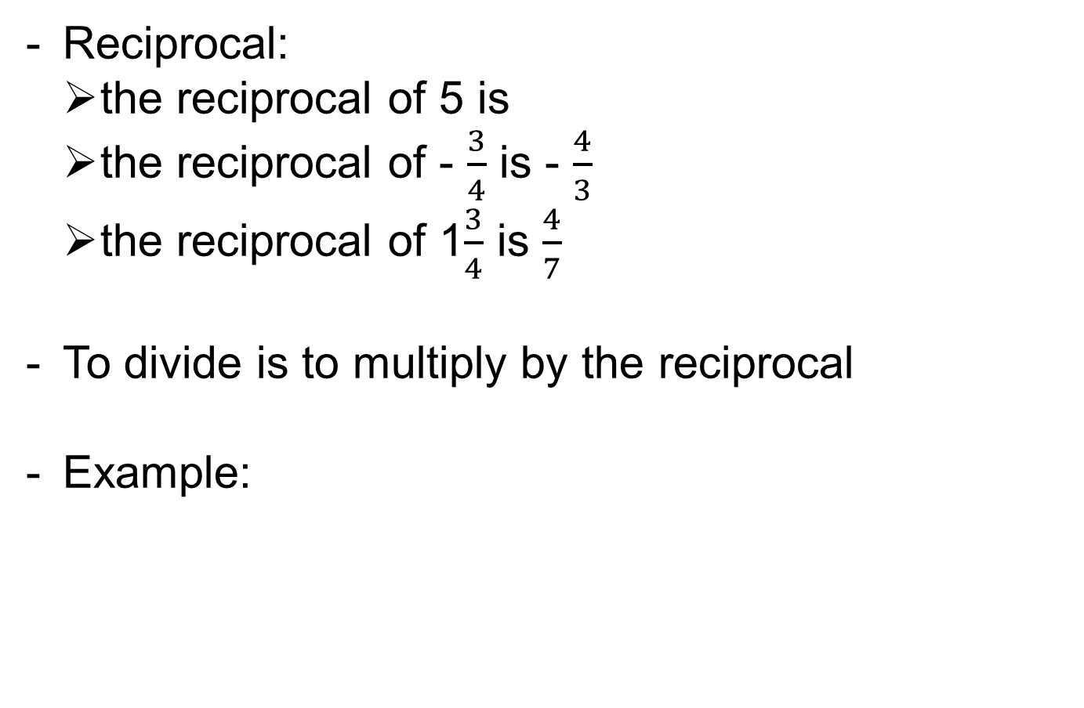
Reciprocal:
  the reciprocal of 5 is
  the reciprocal of - $\frac{3}{4}$ is - $\frac{4}{3}$
  the reciprocal of 1$\frac{3}{4}$ is $\frac{4}{7}$
To divide is to multiply by the reciprocal
Example:
$$\frac{25}{\frac{1}{2}}=25⋅2=50$$

Slide 7
Divisibility
A number is divisible by 2 (even) if
the last digit is 0, 2, 4, 6 or 8.
A number is divisible by 3 if
the sum of the digits is divisible by 3
A number is divisible by 5 if
the last digit is 0 or 5

Slide 8
Prime numbers
A prime number is a positive integer, greater than 1, that is divisible only by 1 and itself.
The first ten prime numbers are:
2, 3, 5, 7, 11, 13, 17, 19, 23, 29
Each whole number is uniquely determined by its prime factors

Slide 9
Arbor factor decomposition
60
2 -----
30
2 -----
15
3 -----
5
5 -----
1
24
2 -----
12
2 -----
6
2 -----
3
3 -----
1
So: 60 = 2∙2∙3∙5
So: 24 = 2∙2∙2∙3
The greatest common divisor (GCD) of 60 and 24 is
2∙2∙3 = 12
The least common multiple (LCM) of 60 and 24 is
2∙2∙2∙3∙5 = 120

Slide 10
Another prime factor decomposition
60
2 -----
30
2 -----
15
3 -----
5
5 -----
1
130
2 ------
65
5 ------
13
13 ------
1
So: 60 = 2∙2∙3∙5
So: 130 = 2∙5∙13
The greatest common denominator (GCD) of 60 and 130 is
2∙5 = 10
The least common multiple (LCM) of 60 and 130 is
2∙2∙3∙5∙13

Slide 11

Simplifying fractions
The value of a fraction does not change when numerator and denominator are multiplied by the same number.
Example:
Simplify: divide numerator and denominator by the GGD of numerator and denominator
$$\frac{2}{3}=\frac{2⋅5}{3⋅5}=\frac{10}{15}$$

Slide 12
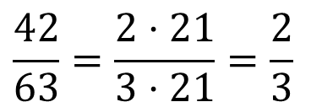
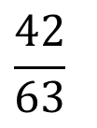
Example of simplifying
$$\frac{42}{63}$$
42 = 2∙3∙7
63 = 3∙3∙7
So: GGD of 42 and 63 is 3∙7 = 21
So:
$$\frac{42}{63}=\frac{2⋅21}{3⋅21}=\frac{2}{3}$$

Slide 13
Adding fractions
You add two fractions with the same denominator by adding the numerators, keeping the denominator equal
Subtraction is addition of its opposite
Two fractions with different denominators can only be added or subtracted after making them equal
Making dominators equal is done with the LCM

Slide 14

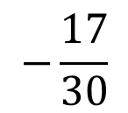
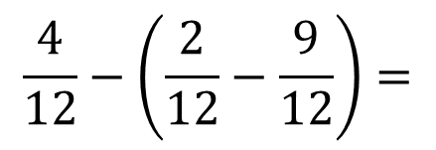

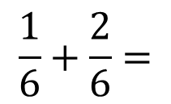
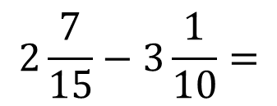
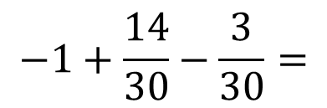
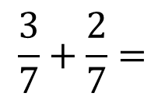
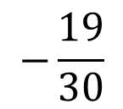
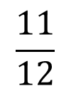
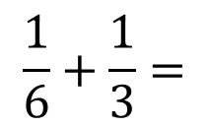
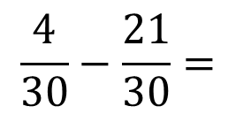
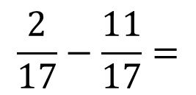
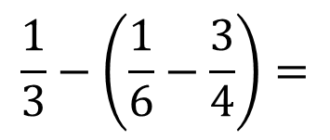
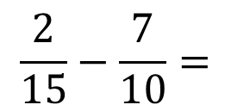
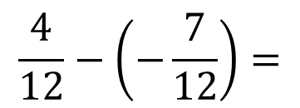
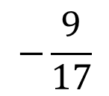
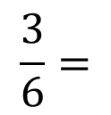
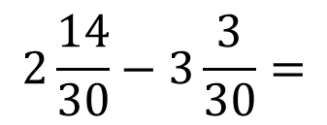
Addition and subtraction examples
$$\frac{3}{7}+\frac{2}{7}=$$
$$\frac{5}{7}$$
$$\frac{2}{17}−\frac{11}{17}=$$
$$−\frac{9}{17}$$
$$\frac{1}{6}+\frac{1}{3}=$$
$$\frac{1}{6}+\frac{2}{6}=$$
$$\frac{3}{6}=$$
$$\frac{1}{2}$$
$$\frac{2}{15}−\frac{7}{10}=$$
$$\frac{4}{30}−\frac{21}{30}=$$
$$−\frac{17}{30}$$
$$2\frac{7}{15}−3\frac{1}{10}=$$
$$2\frac{14}{30}−3\frac{3}{30}=$$
$$−1+\frac{14}{30}−\frac{3}{30}=$$
$$−\frac{19}{30}$$
$$\frac{1}{3}−\left(\frac{1}{6}−\frac{3}{4}\right)=$$
$$\frac{4}{12}−\left(\frac{2}{12}−\frac{9}{12}\right)=$$
$$\frac{4}{12}−\left(−\frac{7}{12}\right)=$$
$$\frac{11}{12}$$

Slide 15
Compound fractions
A compound fraction is a combination of a whole number and a fraction
A simple fraction is a fraction consisting only of a numerator and a denominator
You can turn a compound fraction into a simple fraction by turning the whole part into a fraction with the same denominator
You can turn a simple fraction into a compound fraction by long division

Slide 16






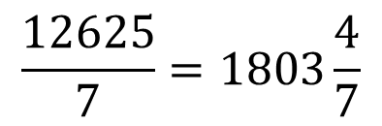





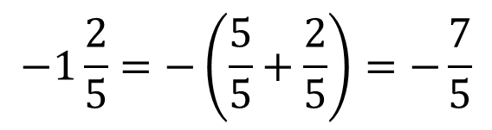





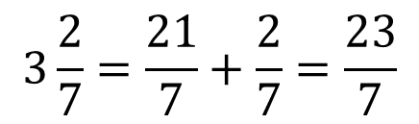


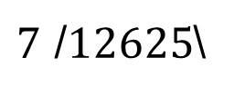






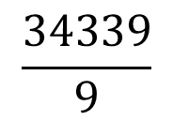




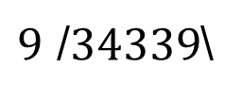




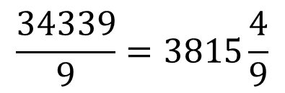


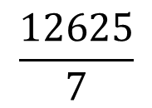


Examples
$$3\frac{2}{7}=\frac{21}{7}+\frac{2}{7}=\frac{23}{7}$$
$$−1\frac{2}{5}=−\left(\frac{5}{5}+\frac{2}{5}\right)=−\frac{7}{5}$$
$$\frac{34339}{9}$$
$$\frac{12625}{7}$$
$$1$$
$$0$$
remainder 4
$$3$$
$$1$$
remainder 4
$7$ /$12625$\
$$8$$
$$3$$
$9$ /$34339$\
$$8$$
$$5$$
$$⋮$$
$$⋮$$
$$⋮$$
$$⋮$$
$$⋮$$
$$⋮$$
$$⋮$$
$$⋮$$
$$⋮$$
$$⋮$$
$$⋮$$
$$⋮$$
$$⋮$$
$$⋮$$
$$⋮$$
$$⋮$$
$$⋮$$
$$⋮$$
$$⋮$$
$$⋮$$
$$⋮$$
$$⋮$$
$$⋮$$
$$⋮$$
$$27$$
$$7$$
$$6$$
$$7$$
$$5$$
$$3$$
$$72$$
$$56$$
$$2$$
$$3$$
$$0$$
$$1$$
$$9$$
$$\frac{34339}{9}=3815\frac{4}{9}$$
$$0$$
$$\frac{12625}{7}=1803\frac{4}{7}$$
$$5$$
$$9$$
$$2$$
$$4$$
$$45$$
$$21$$
$$4$$
$$4$$

Slide 17
Multiplying fractions
DO NOT: equalise dominators
DO: make simple fractions
Multiply numerators, and multiply denominators
See if you can simplify

Slide 18
Dividing fractions
To divide is to multiply by the reciprocal

Slide 19
Working out brackets
Area green rectangle:
Area red rectangle:
Area total rectangle:
So:
The multiplication sign (the dot) is often omitted

Slide 21
Area blue rectangle:
Area red rectangle:
Area green rectangle:
Area purple rectangle:
Area total rectangle:
So:

Slide 22
Examples

Slide 23
Surface blue square:
Area red rectangle:
Area green rectangle:
Surface purple square:
Area total square:
So:

Slide 24
The double product

Slide 25















Examples
$${\left(x+3\right)}^{2}=$$
$$x^{2}+6x+9$$
$${\left(x−4\right)}^{2}=$$
$$x^{2}−8x+16$$
$${\left(2x+3\right)}^{2}=$$
$$4x^{2}+12x+9$$
$$2{\left(x+3\right)}^{2}=$$
$$2x^{2}+12x+18$$
$${\left(−x−4\right)}^{2}=$$
$$x^{2}+8x+16$$
$${\left(x−4\right)}^{2}+{\left(x+1\right)}^{2}=$$
$$x^{2}−8x+16+x^{2}+2x+1=$$
$$2x^{2}−6x+17$$
$$(x+3y)(x−3y)=$$
$$x^{2}−9y^{2}$$

Slide 26
The sum-product formula

Slide 27
Need more explanation and practice?
Go to the course on Brightspace

